Slide 1
Visual Analytics of Movement Behavior Pattern Based on Time-Spatial Data: A Neural Net Approach
Presented by
Zhenghao Chen
Bachelor of Information Technology(Honors)

Slide 2
Background
Time Spatial Data
Format
Motivation
An efficient method to analyze this type of data and understand the embedded pattern
Timestamp | x | y | Other Information
2015-06-06 10:00:01 | 43.2 | 56.3 | Check in location B
2015-06-06 10:00:02 | 22.5 | 57.3 | Check out location A

Slide 3
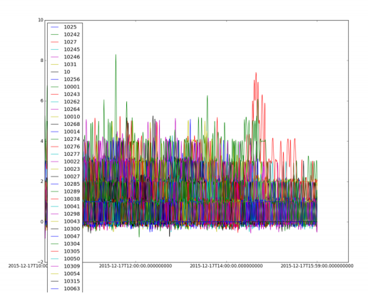
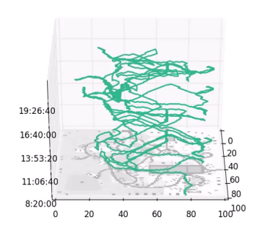
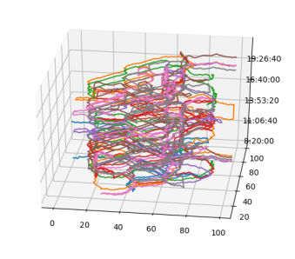
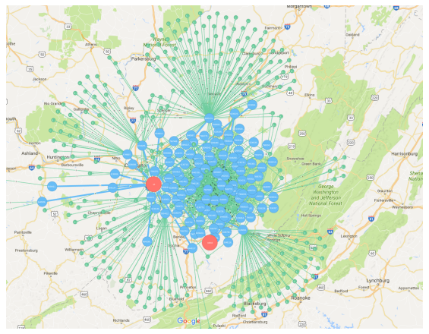
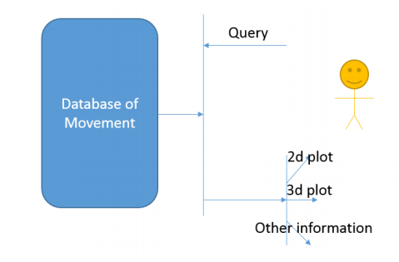
Literature
Conventional Methods
Visual Analytics System[1]
Architecture
Visual Display Methods
2D Map
3D Cube
Statistic
Feature Extraction[2][3]
Machine Learning
Classification
Clustering
Deep Learning[4]
Prediction

Slide 4
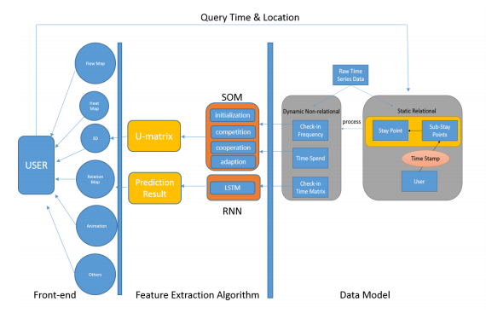
Our Method - Overview
Neural Net-based Visualization Framework
Back-end
Static → dynamic
Algorithm
SOM-based Clustering
RNN-based Prediction
Front-end
Visual Analytics Tool

Slide 5
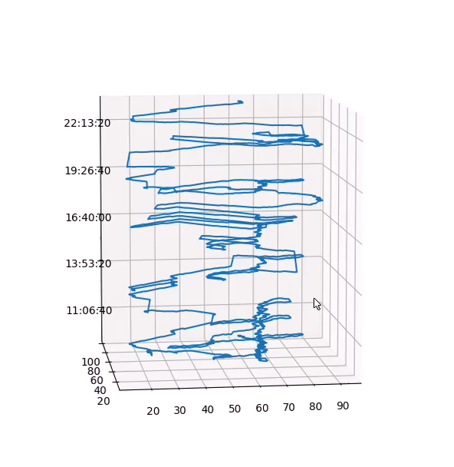

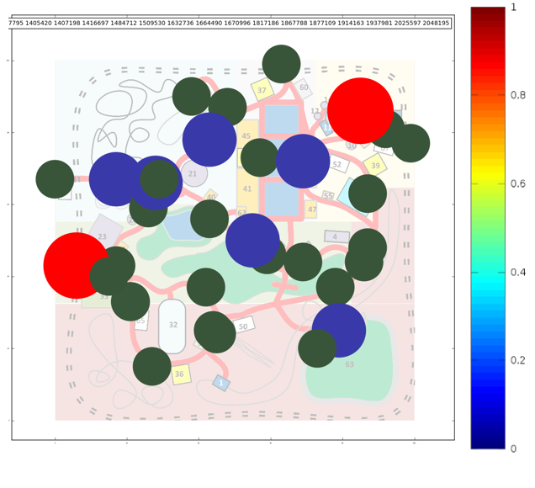
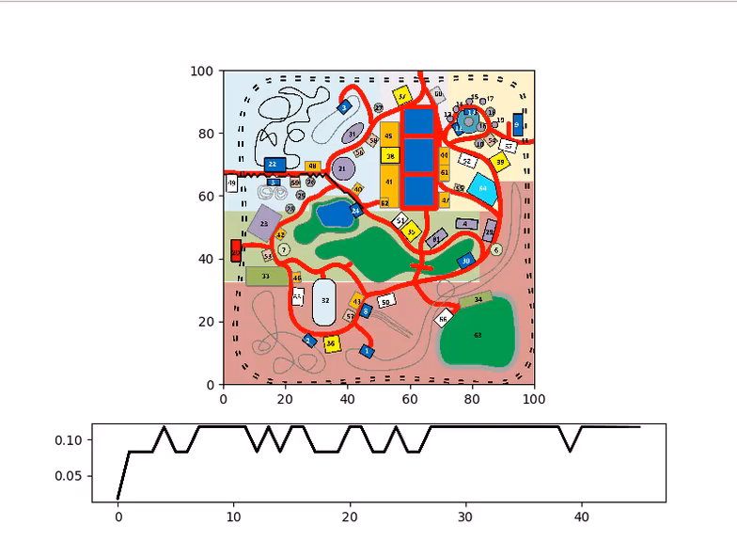
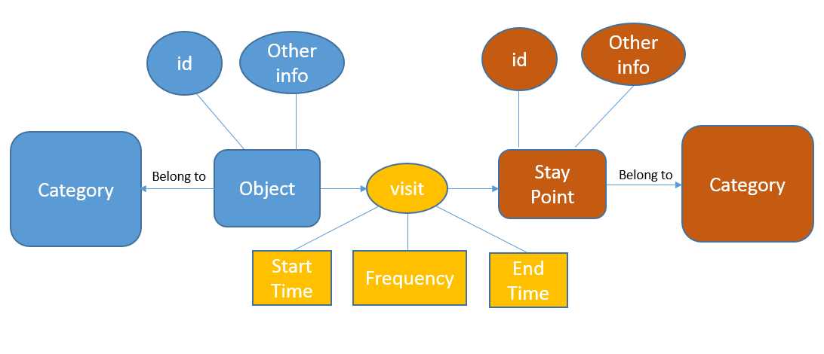
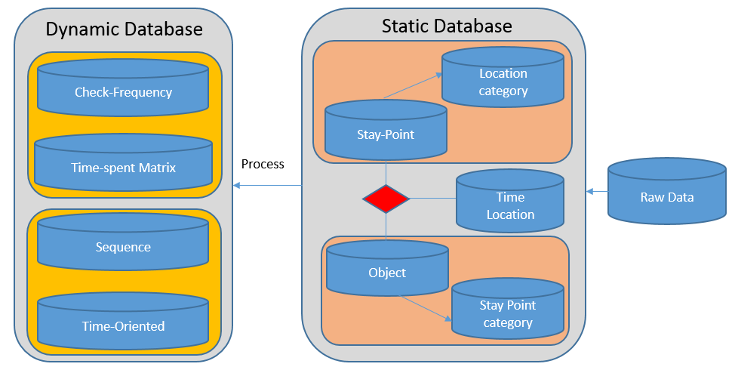
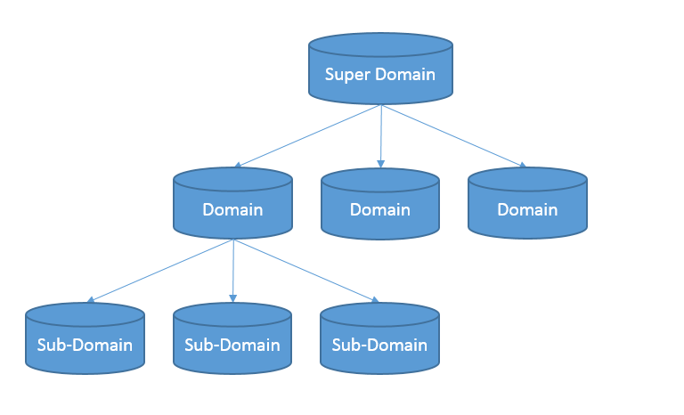
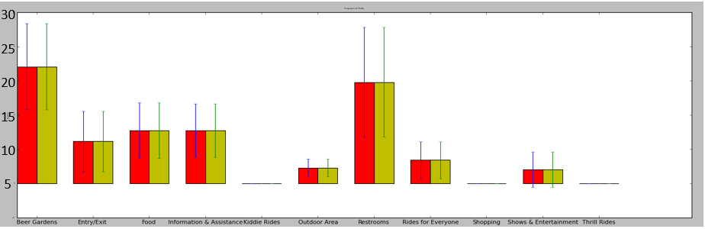
Our Method – A Static to Dynamic Data Model
A Static to Dynamic Data Model
Static Relational Data Model
Relationship
Tree Structure
Index
Dynamic Data Model
Time-spend Matrix
Check-in Frequency Matrix
Sequence Matrix
Time-oriented Vector

Slide 6
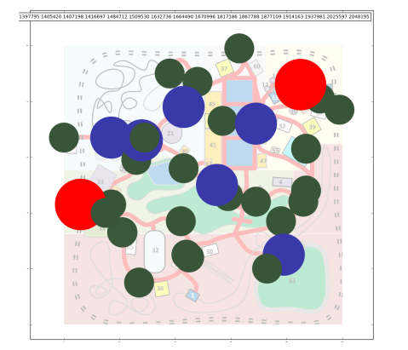
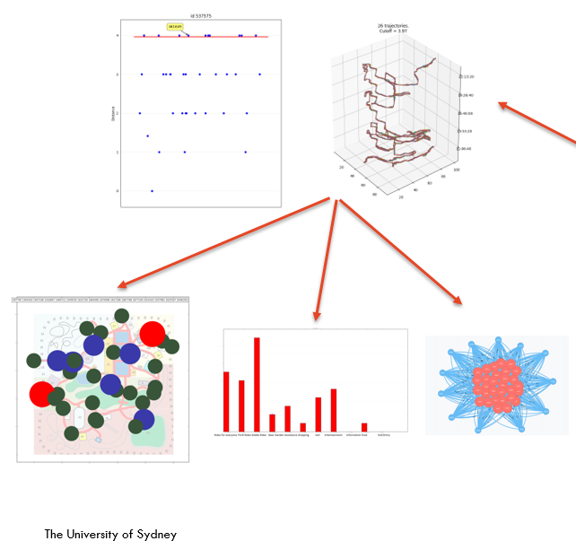
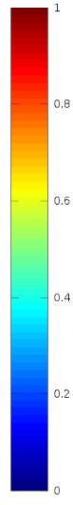
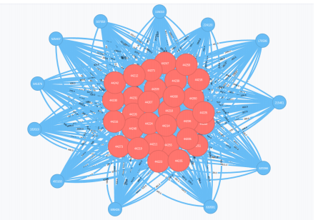
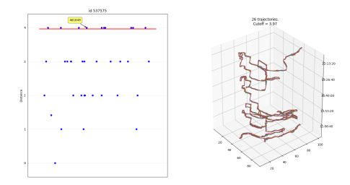
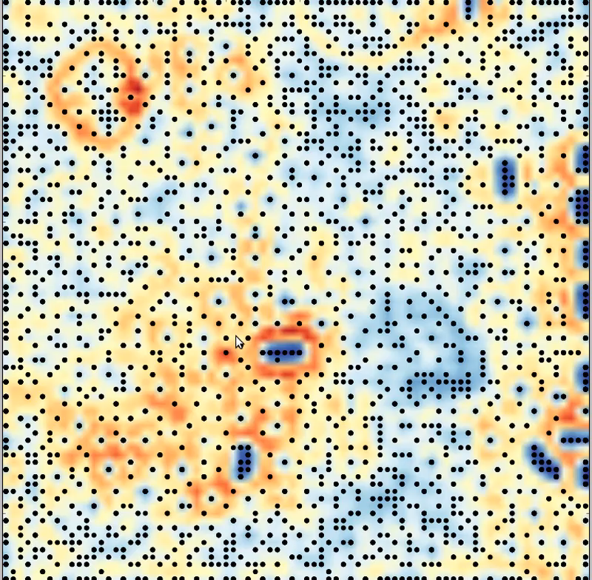
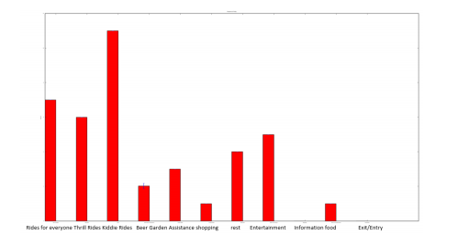
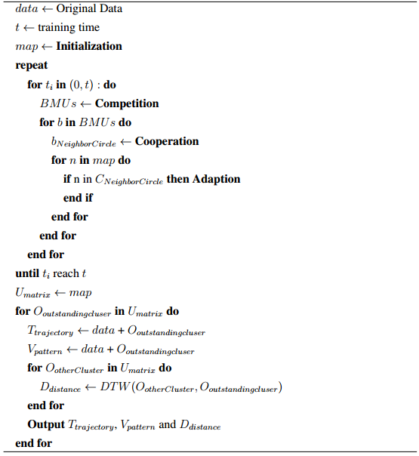
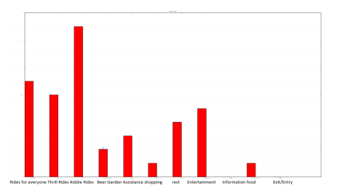
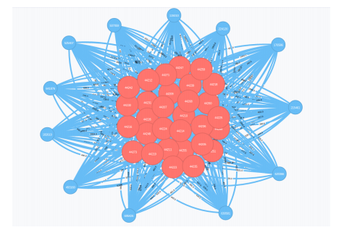
Our Method – Self-organizing Map based Clustering
Self-organizing Map Based Clustering
Algorithm[5]
Initialization
Competition
Cooperation
Adaption

Slide 7
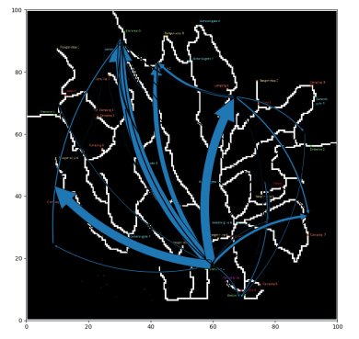
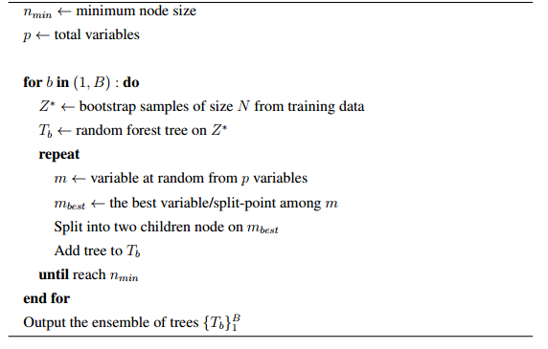
Our Method – Deep Learning based Prediction
Deep Learning-based Prediction
Classification Method
KNN
SVM
Decision Tree
Random Forest
Deep Learning-based Method
Recurrent Neural Net[6]
Long-short Term Memory

Slide 8
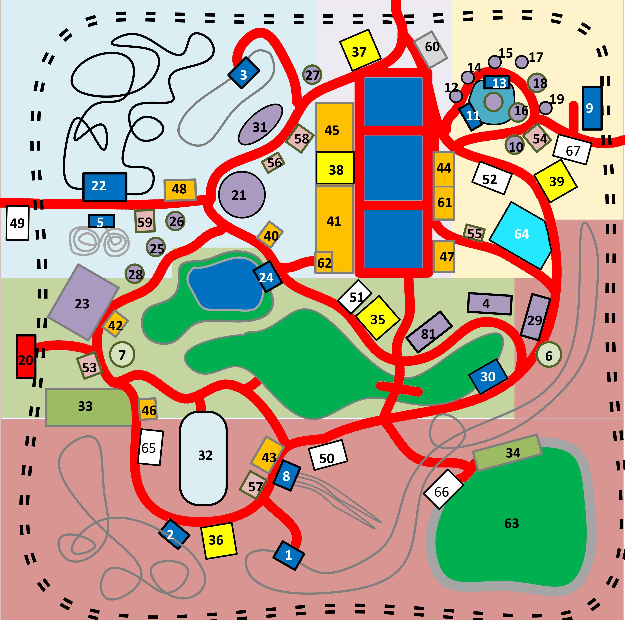
Experiment 1– Park Management
VAST Challenge 2015*
Data Format
Task
Crime Occur on Sunday in Attraction 32
Give Suggestions for Park Management
Time Stamp | Visitor | (x,y) | Behavior
07-06-14 12:00:00 | 10801 | 23,40 | Check-in
*http://vacommunity.org/VAST+Challenge+2015

Slide 9
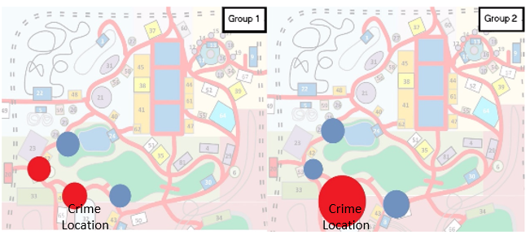
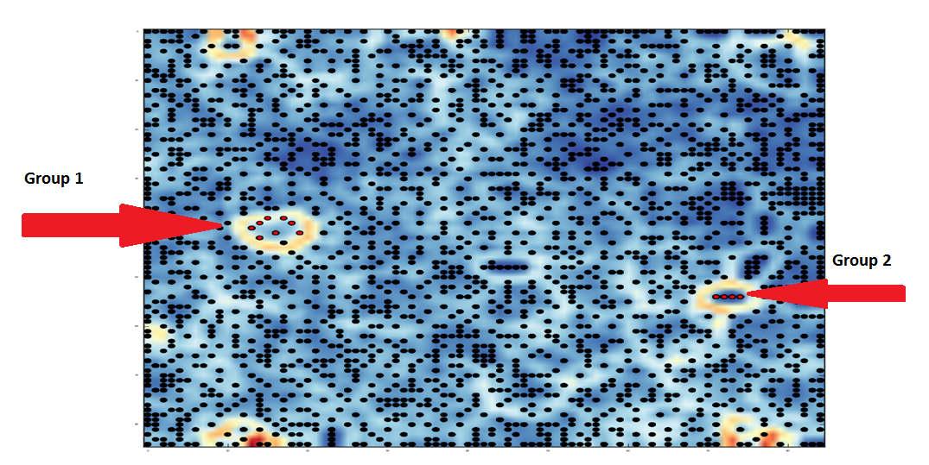
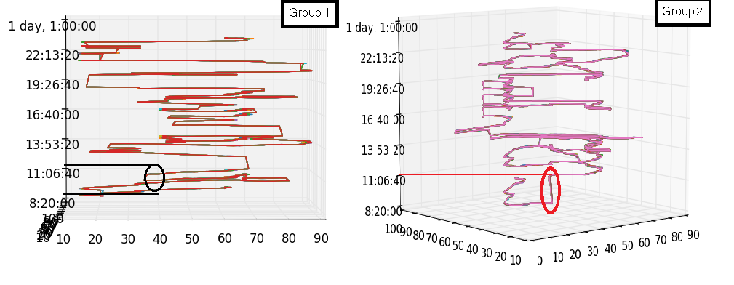
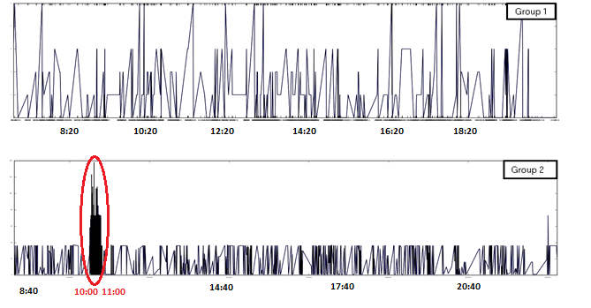
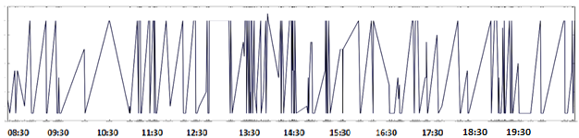
Experiment 1– Park Management
Crime Detection

Slide 10
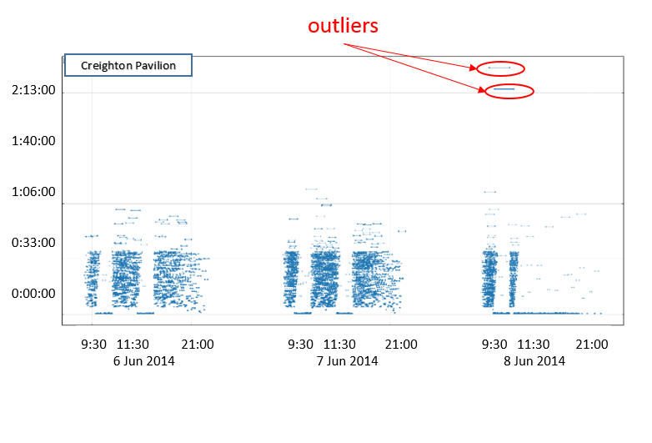
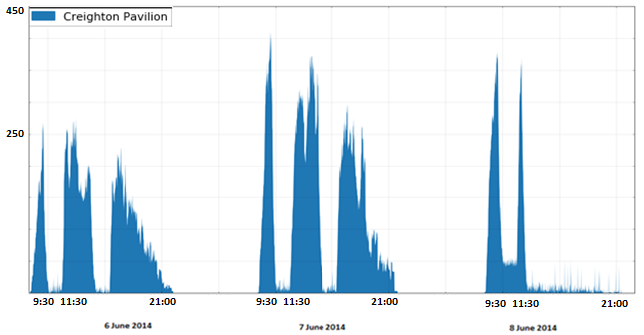
Experiment 1– Park Management
Crime Detection
Conclusion
Crime Time: 10:00 - 11:00
Group 2: commit crime
Group 1: assist crime

Slide 11
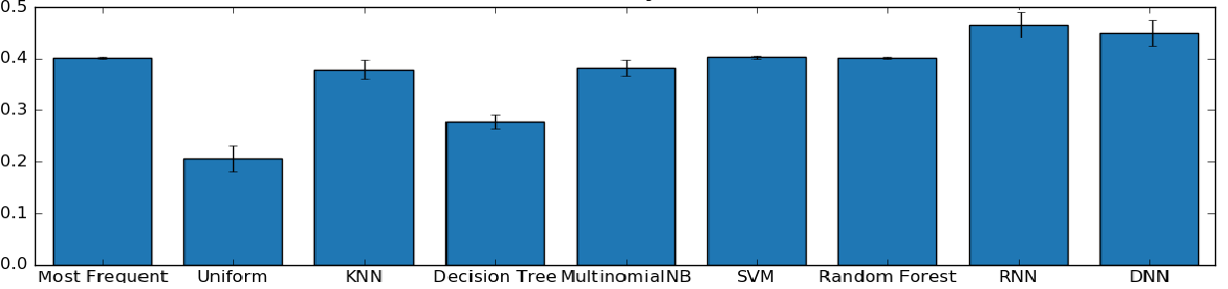
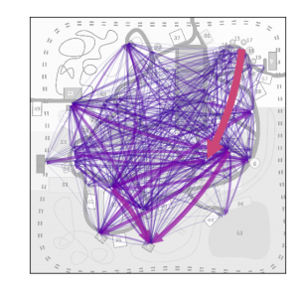
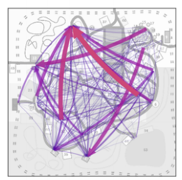
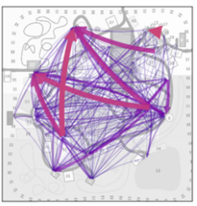
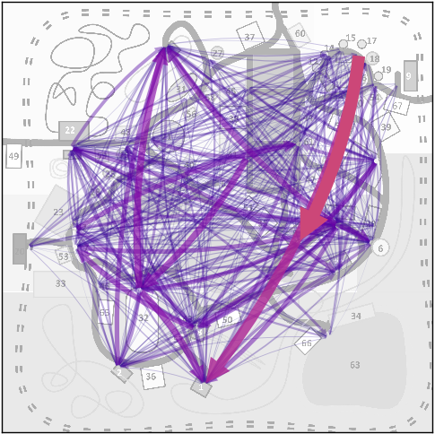
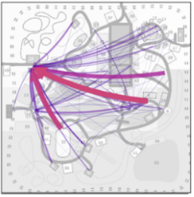
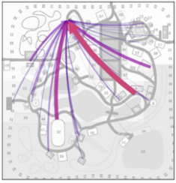
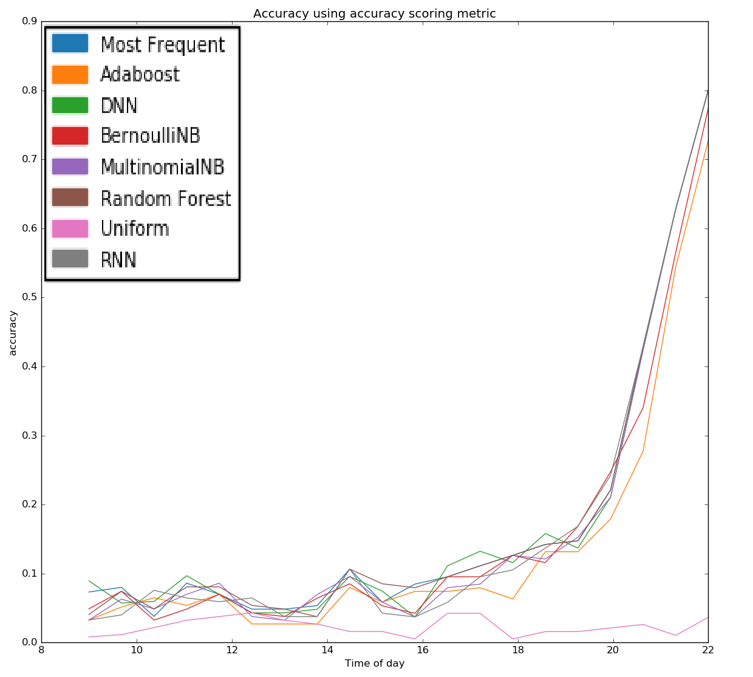
Experiment 1 – Park Management
Prediction Of Movement Flow
Evaluation
Visualization
RNN
Most Frequent
Naïve Bayes
Actual Movement
Random Forest
KNN

Slide 12
Experiment 2 – Commercial Promotion for Mobile User
Chinese Mobile Company Data
Data Format
Motivation
Give advice for commercial activity
Time Stamp | Geo-information | Station | IP
06-01-2015 10:00:00 | (x,y) | 10 | 10.00.79.523

Slide 13
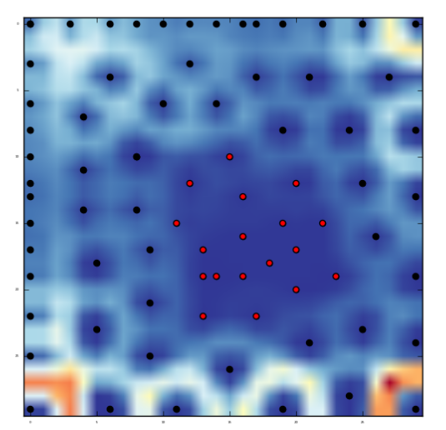
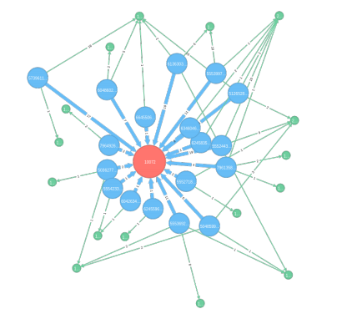
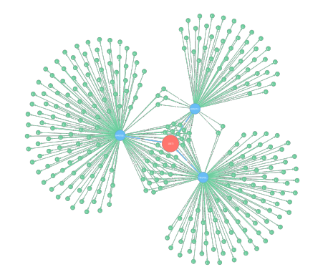
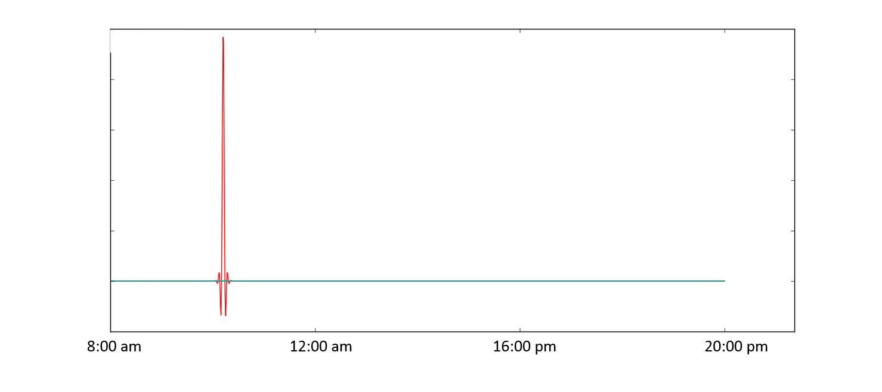
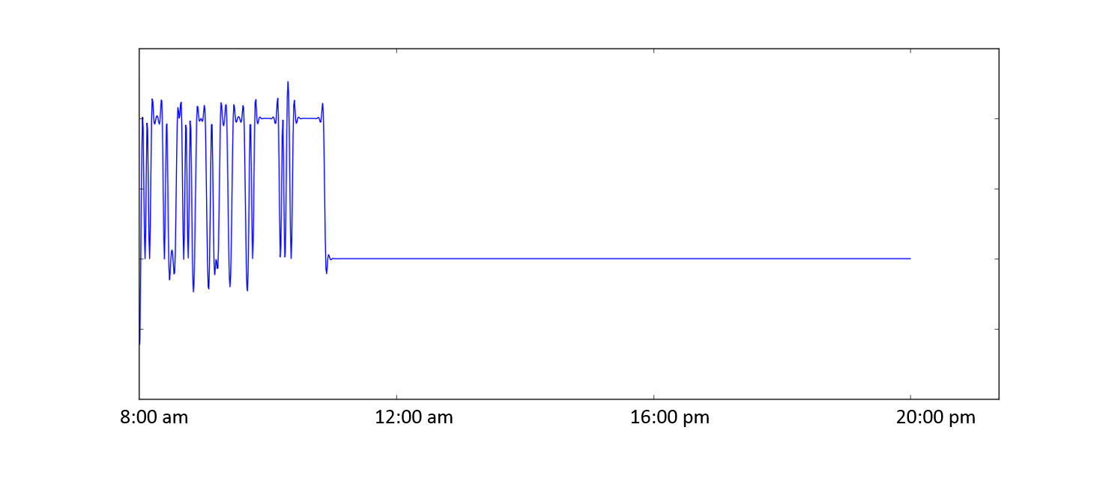
Experiment 2 – Commercial Promotion for Mobile User
Outstanding User Detection
Regular User
Outstanding User

Slide 14
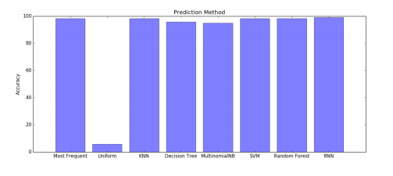
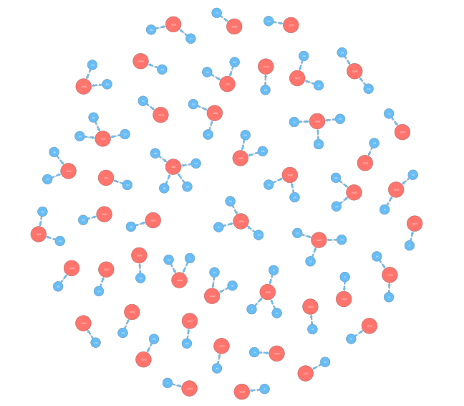
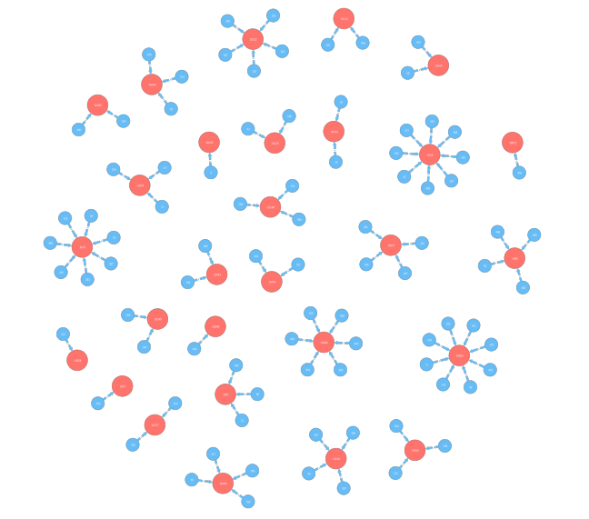
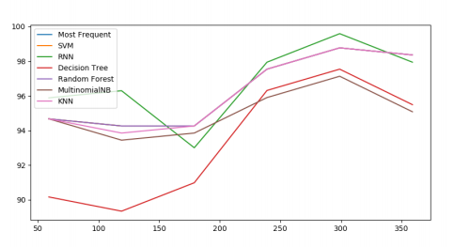
Experiment 2 – Commercial Promotion for Mobile User
Prediction Of Station Usage
Evaluation
Prediction Result
Actual Usage
Prediction Usage

Slide 15

Experiment 3 – Traffic Patterns in Nature Preserve
VAST Challenge 2017*
Data Format
Motivation
Analyze abnormal pattern
Analyze affects on wildlife
Time Stamp | location | type
15-06-16 12:00:00 | Gate 1 | Large Truck
*http://vacommunity.org/VAST+Challenge+2017

Slide 16







Experiment 3
Abnormal Pattern

Slide 17




Experiment 3 – Traffic Patterns in Nature Preserve
Regular Pattern

Slide 18








Experiment 3 – Traffic Patterns in Nature Preserve
Prediction
Evaluation
Visualization
KNN
Random Forest
RNN
Actual Movement
Most Frequent
SVM

Slide 19
Conclusion
• Set up a time-spatial data visual analytics pipeline to understand movement behavior
• Modify and utilize Artificial Neural Net approach to propose a clustering (SOM) and prediction (RNN)methodology
• Participate in two public challenges (VAST 2015 & VAST 2017) and provide suggestion to a Chinese Mobile Company

Slide 20
Publication
Conferences
[1] Zhenghao Chen, J. Zhou, X. Wang, J. Swanson, F. Chen, D. Feng “Neural Net Based and Safety-Oriented Visual Analytics for Time-Spatial Data” IEEE International Joint Conference on Neural Networks 2017 (IJCNN 2017)
[2] Zhenghao Chen, J. Zhou, X. Wang “Abnormal Trajectory Pattern Detection and Visualization using Neural Net” IEEE Visual Analytics Science and Technology 2017 (VAST 2017) Submitted
Journal
[1] Zhenghao Chen, J. Zhou, X. Wang, F. Chen, D. Feng, H. Cui “Visual Analytics of Movement Behavior Pattern Based on Time-Spatial Data: A Neural Net Approach” IEEE Transactions on Human-Machine Systems, Submitted

Slide 21


Acknowledgement
Thanks to Following Organizations and People
Dr Xiuying Wang (Supervisor) & Dr Jianlong Zhou (Co-supervisor)
The University of Sydney & CSIRO Data61

Slide 22
Reference
[1] Yu Zheng, Lizhu Zhang, Xing Xie, and Wei-Ying Ma, “Mining interesting locations and travel sequences from GPS trajectories,” in Proceedings of the 18th international conference on World wide web. ACM, 2009, pp. 791–800.
[2] Natalia Andrienko and Gennady Andrienko, “Visual analytics of movement: An overview of methods, tools and procedures,” Information Visualization, vol. 12, no. 1, pp. 3–24, 2013.
[3] Yu Zheng, “Trajectory data mining: an overview,” ACM Transactions on Intelligent Systems and Technology (TIST), vol. 6, no. 3, pp. 29, 2015.
[4] Qiang Liu, Shu Wu, Liang Wang, and Tieniu Tan, “Predicting the Next Location: A Recurrent Model with Spatial and Temporal Contexts.,” in AAAI, 2016, pp. 194–200.
[5] Teuvo Kohonen, “The self-organizing map,” Neurocomputing, vol. 21, no. 1, pp. 1–6, 1998.
[6] Yann LeCun, Yoshua Bengio, and Geoffrey Hinton, “Deep learning,” Nature, vol. 521, no. 7553, pp. 436–444, 2015.

Slide 23
Thank You Q & A

